Slide 1


Avishek Bhattacharjee
09/15/2022

Slide 2

Outline
Executive Summary
Introduction
Methodology
Results
Conclusion

Slide 3
Executive Summary
Summary of methodologies
Data Collection
Data Wrangling
EDA with Data Visualization
EDA with SQL
Building an interactive map with Folium
Building a dashboard with Plotly Dash
Predictive Analysis(Classification)
Summary of all results
EDA results
Interactive analytics
Predictive Analysis

Slide 4
Introduction
Project background and context
SpaceX advertises Falcon 9 rocket launches on its website, with a cost of 62 million dollars; other provider's cost
upward of 165 million dollars each, much of the savings is because SpaceX can reuse the first stage.
Problems you want to find answers
The project task is to predict if the Falcon 9 first stage will land successfully

Slide 5

Section 1

Slide 6
Methodology
Executive Summary
Data collection methodology:
SpaceX Rest API
Web Scrapping from Wikipedia
Perform data wrangling
One Hot Encoding data fields for Machine Learning and data cleaning of null values and irrelevant columns
Perform exploratory data analysis (EDA) using visualization and SQL
Perform interactive visual analytics using Folium and Plotly Dash
Perform predictive analysis using classification models
Logistic Regression, KNN, SVM, Decision Tree models have been built and evaluated for best classifier.

Slide 7
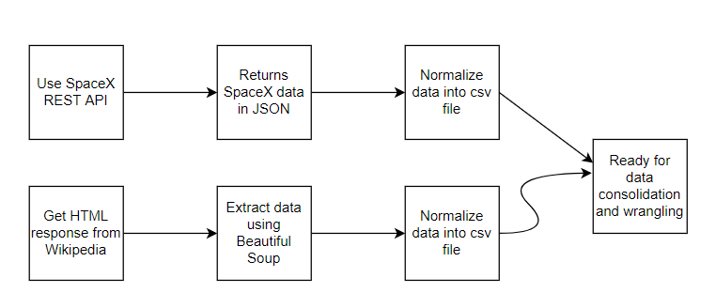
Data Collection
The following data sets were collected
SpaceX data launch that is gathered from the SpaceX REST API
This API will give us data about launches, including information about rocket used, payload delivered, launch specifications, landing specifications, and landing outcome
The SpaceX REST API endpoints, or URL , starts with api.spacexdata.com/v4
Another popular data source for obtaining Falcon9 Launch data is web scrapping Wikipedia using Beautiful Soup

Slide 8
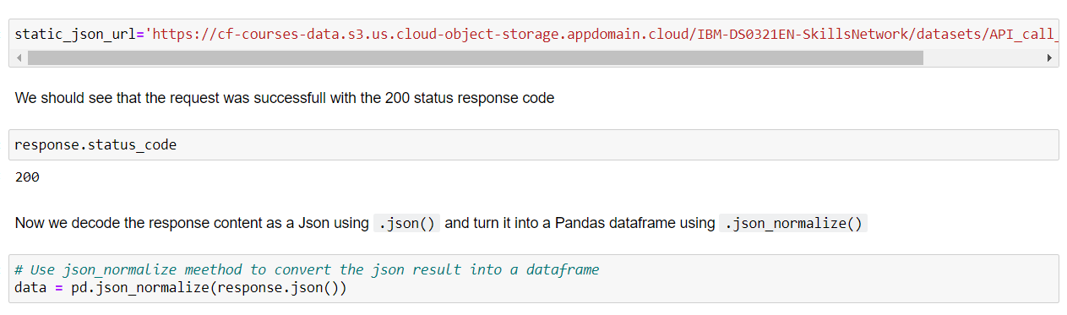
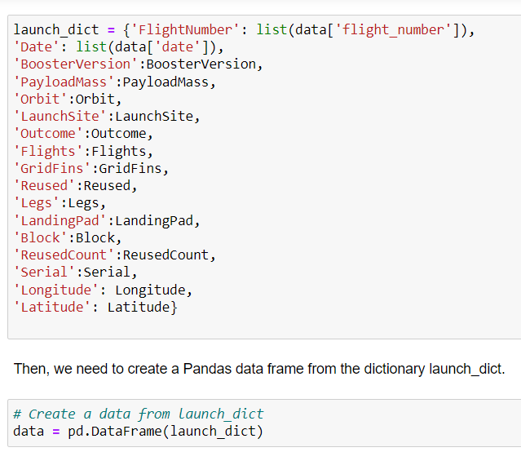
Data Collection – SpaceX API
Data Collection with SpaceX REST API
https://github.com/avi-ds-pjt/ibm-ds-capstone-project/blob/master/jupyter-labs-spacex-data-collection-api.ipynb

Slide 9
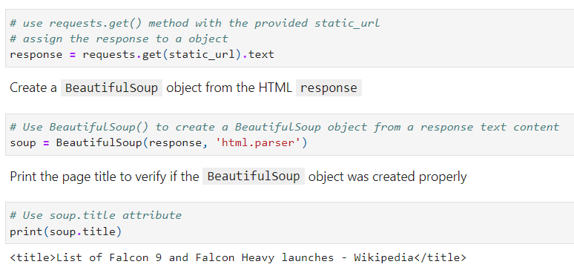
Data Collection - Scraping
Web Scrapping from Wikipedia
https://github.com/avi-ds-pjt/ibm-ds-capstone-project/blob/master/Web%20Scrapping.ipynb

Slide 10
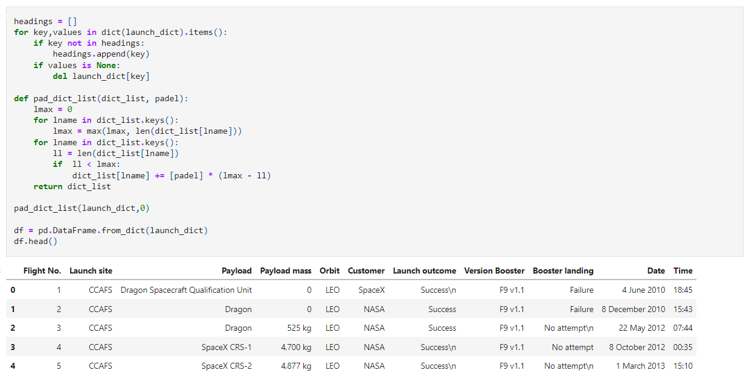
Data Collection – Scraping (Contd.)

Slide 11
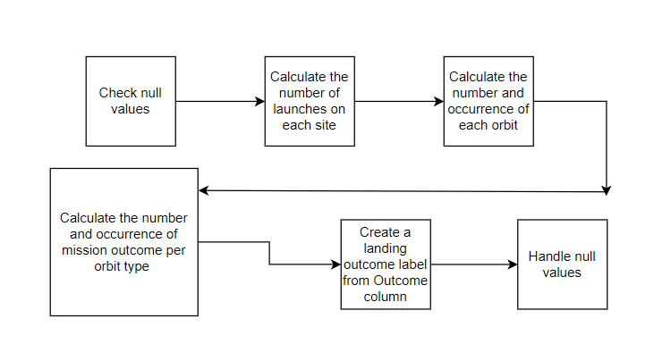
Data Wrangling
https://github.com/avi-ds-pjt/ibm-ds-capstone-project/blob/master/Data%20Wrangling.ipynb

Slide 12
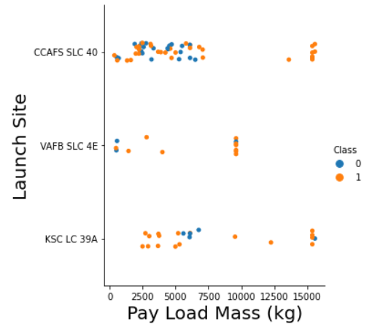
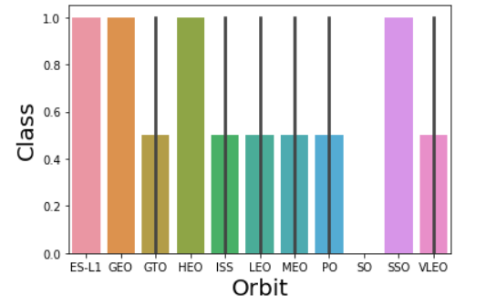
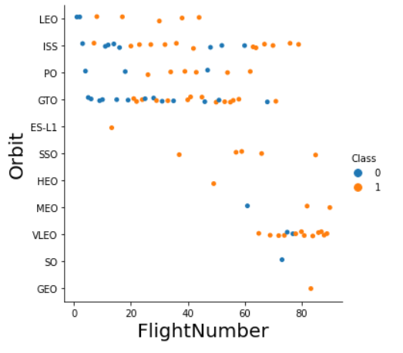
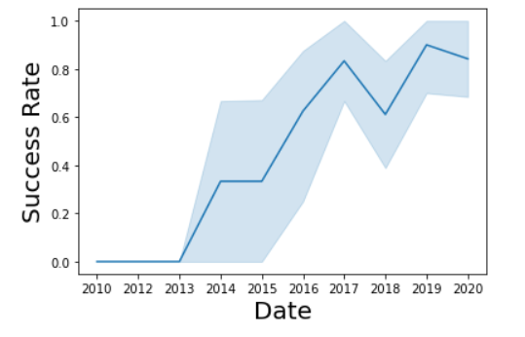
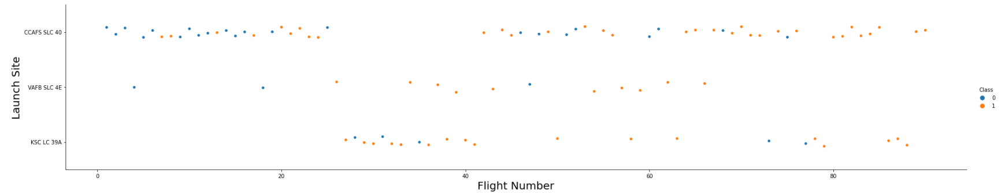
EDA with Data Visualization
https://github.com/avi-ds-pjt/ibm-ds-capstone-project/blob/master/EDA_Data%20Visualization.ipynb

Slide 13
EDA with SQL
SQL operations performed here are:
Displaying the names of the unique launch sites in the space mission
Displaying 5 records where launch sites with the string 'CCA'
Displaying the total payload mass carried by boosters launched by NASA (CRS)
Displaying average payload mass carried by booster version F9 v1.1
Listing the date when the first successful landing outcome in ground pad was achieved.
Listing the names of the boosters which have success in drone ship and have payload mass greater than 4000 but less than 6000
Listing the total number of successful and failure mission outcomes
Listing the names of the booster versions which have carried the maximum payload mass.
Listing the failed landing outcomes in drone ship, their booster versions, and launch site names for in year 2015
Ranking the count of landing outcomes (such as Failure (drone ship) or Success (ground pad)) between the date 2010-06-04 and 2017-03-20, in descending order
https://github.com/avi-ds-pjt/ibm-ds-capstone-project/blob/master/EDA_SQL.ipynb

Slide 14
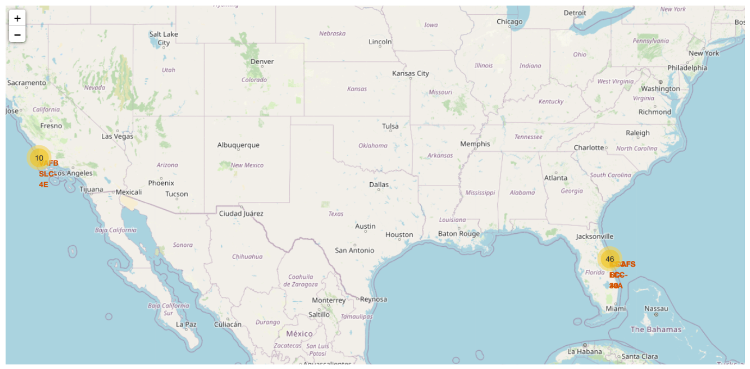
Build an Interactive Map with Folium
https://github.com/avi-ds-pjt/ibm-ds-capstone-project/blob/master/Visual%20Analytics%20with%20Folium.ipynb

Slide 15
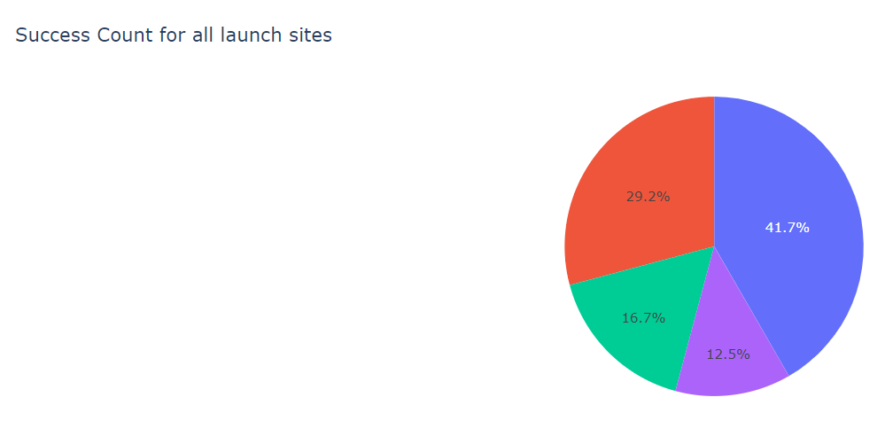
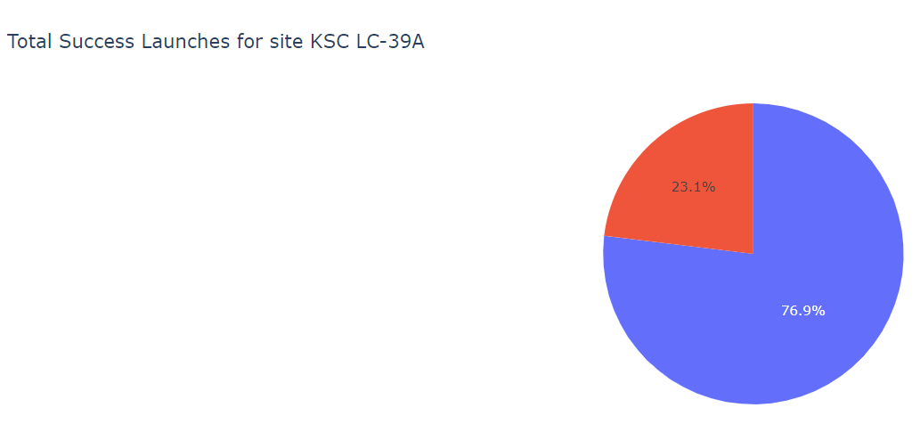
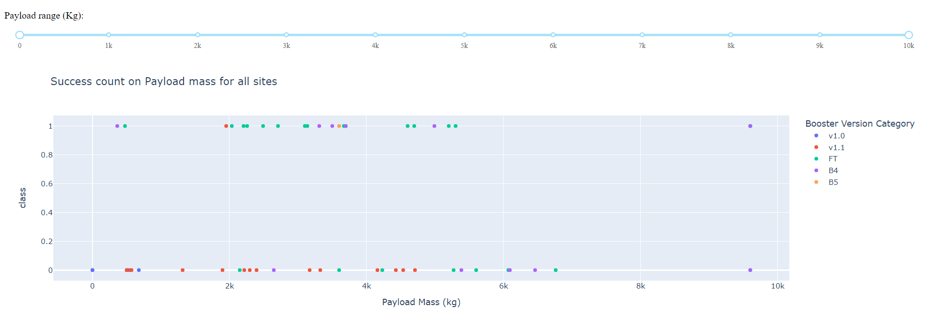
Build a Dashboard with Plotly Dash
https://github.com/avi-ds-pjt/ibm-ds-capstone-project/blob/master/spacex_dash_app.py

Slide 16
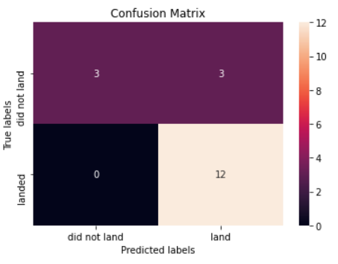

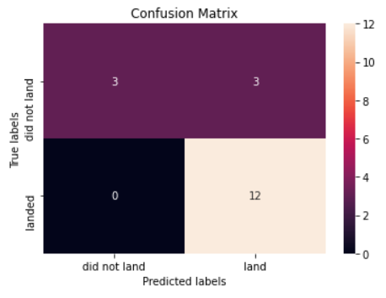
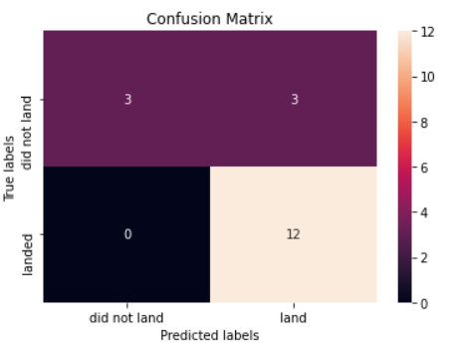
Predictive Analysis (Classification)
Logistic Regression, SVM and KNN accuracy stayed at around 83% but Decision Tree shoot up to 94%
https://github.com/avi-ds-pjt/ibm-ds-capstone-project/blob/master/SpaceX_Machine%20Learning%20Prediction.ipynb

Slide 17
Results
SVM, KNN and Logistic Regression is best in terms of accuracy.
Decision Tree results looks overfitted
Low-weighted payloads perform better than heavy-weight payloads
The success rates of SpaceX launches is directly proportional to time. With advancement in technology and in years to come they will perfect the launches.
KSC LC-39A and VAFB SLC 4E has success rates of 77%
LEO orbit the Success appears related to the number of flights; on the other hand, there seems to be no relationship between flight number when in GTO orbit.

Slide 18

Section 2

Slide 19
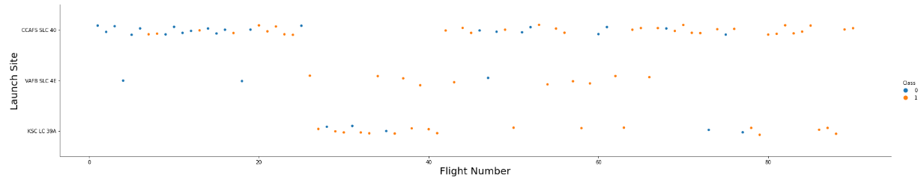
Flight Number vs. Launch Site
Launches from CCAFS SLC40 are higher as compared to other launch sites.

Slide 20
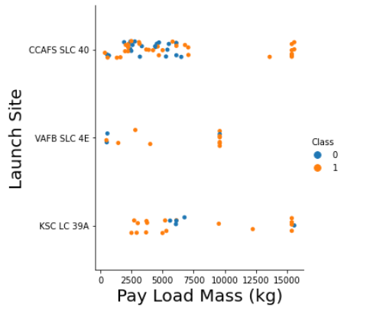
Payload vs. Launch Site
For the VAFB-SLC launch site there are no rockets launched for heavy payload mass(greater than 10000).
Most payloads with lower mass have been launched from CCAFS SLC40

Slide 21
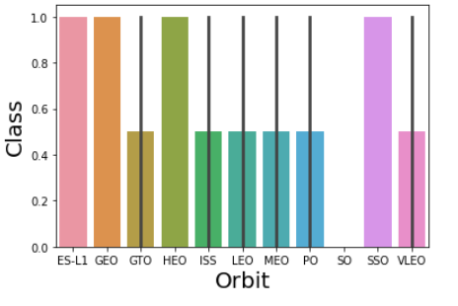
Success Rate vs. Orbit Type
The orbit types mentioning ES-L1, GEO, HEO, SSO are among the highest success rate.

Slide 22
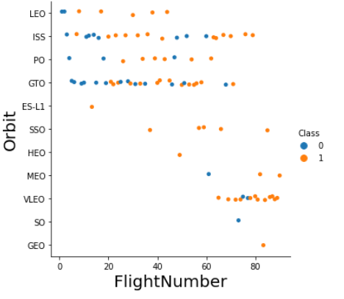
Flight Number vs. Orbit Type
The LEO orbit the Success appears related to the number of flights; on the other hand, there seems to be no relationship between flight number when in GTO orbit.
Recent trend shows shift to VLEO launches in recent years.

Slide 23
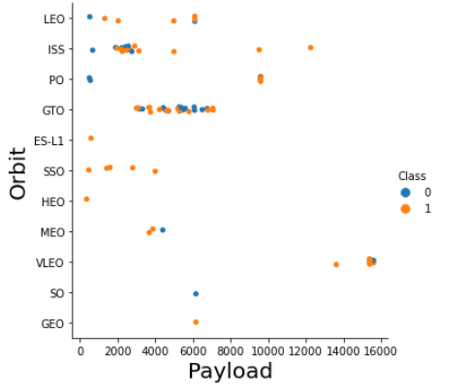
Payload vs. Orbit Type
With heavy payloads the successful landing or positive landing rate are more for Polar, LEO and ISS.
However, for GTO we cannot distinguish this well as both positive landing rate and negative landing(unsuccessful mission) are both there here.
There are strong correlation between ISS and Payload at the range around 2000, similarly between GTO and the range 4000-8000

Slide 24
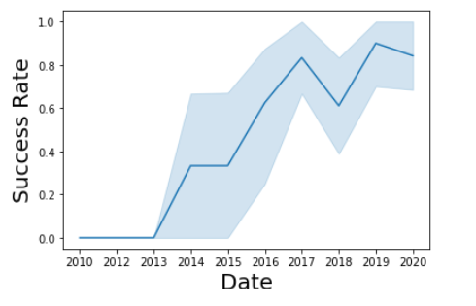
Launch Success Yearly Trend
Launch success rate has increased significantly since 2013 and has stabilized since 2019, mostly because of the advancement of technology and lessons learned.

Slide 25
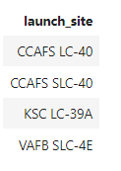
All Launch Site Names
%sql select distinct(LAUNCH_SITE) from SPACEXDATASET

Slide 26
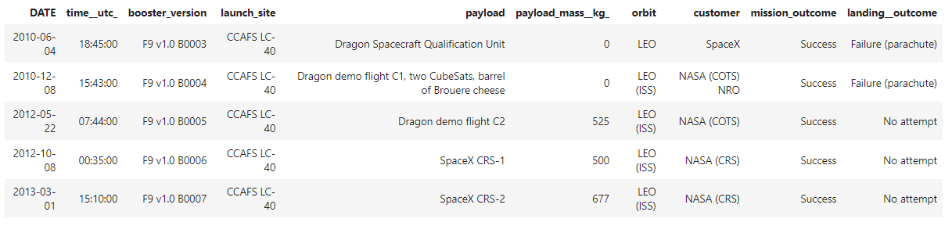
Launch Site Names Begin with 'CCA'
%sql select * from SPACEXDATASET where LAUNCH_SITE like 'CCA%' limit 5

Slide 27
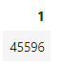
Total Payload Mass
%sql select sum(PAYLOAD_MASS__KG_) from SPACEXDATASET where CUSTOMER = 'NASA (CRS)’

Slide 28
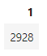
Average Payload Mass by F9 v1.1
%sql select avg(PAYLOAD_MASS__KG_) from SPACEXDATASET where BOOSTER_VERSION = 'F9 v1.1’

Slide 29
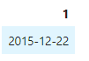
First Successful Ground Landing Date
%sql select min(DATE) from SPACEXDATASET where Landing__Outcome = 'Success (ground pad)’

Slide 30
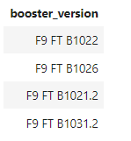
Successful Drone Ship Landing with Payload between 4000 and 6000
%sql select BOOSTER_VERSION from SPACEXDATASET where Landing__Outcome = 'Success (drone ship)' and PAYLOAD_MASS__KG_ > 4000 and PAYLOAD_MASS__KG_ < 6000

Slide 31
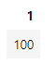
Total Number of Successful and Failure Mission Outcomes
%sql select count(MISSION_OUTCOME) from SPACEXDATASET where MISSION_OUTCOME = 'Success' or MISSION_OUTCOME = 'Failure (in flight)’

Slide 32
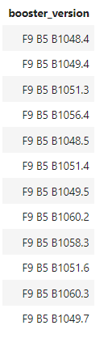
Boosters Carried Maximum Payload
%sql select BOOSTER_VERSION from SPACEXDATASET where PAYLOAD_MASS__KG_ = (select max(PAYLOAD_MASS__KG_) from SPACEXDATASET)

Slide 33
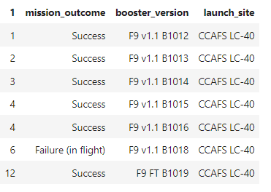
2015 Launch Records
%sql SELECT MONTH(DATE),MISSION_OUTCOME,BOOSTER_VERSION,LAUNCH_SITE FROM SPACEXDATASET where EXTRACT(YEAR FROM DATE)='2015’;

Slide 34
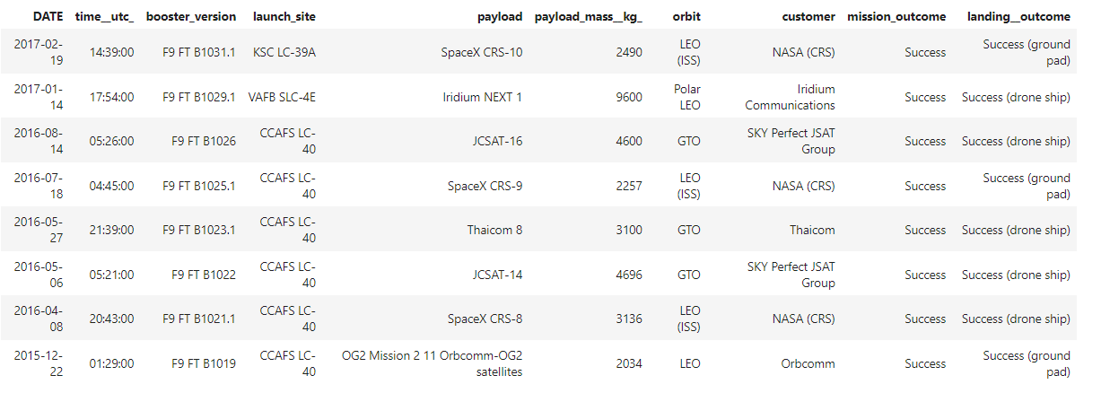
Rank Landing Outcomes Between 2010-06-04 and 2017-03-20
%sql select * from SPACEXDATASET where Landing__Outcome like 'Success%' and (DATE between '2010-06-04' and '2017-03-20') order by date desc

Slide 35

Section 3

Slide 36
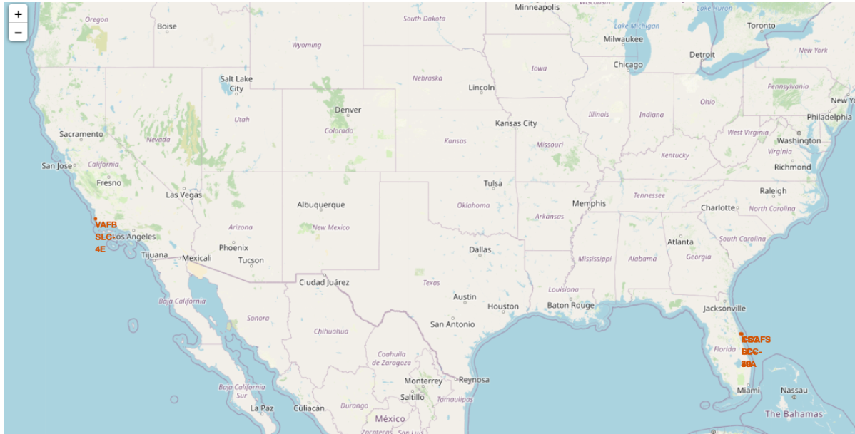
All launch sites marked on a map

Slide 37
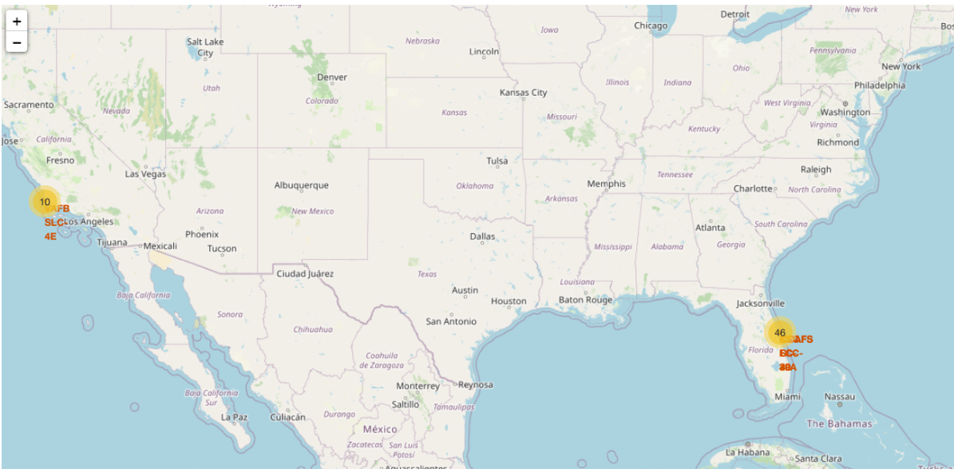
Success/Failed launches marked on the map

Slide 38
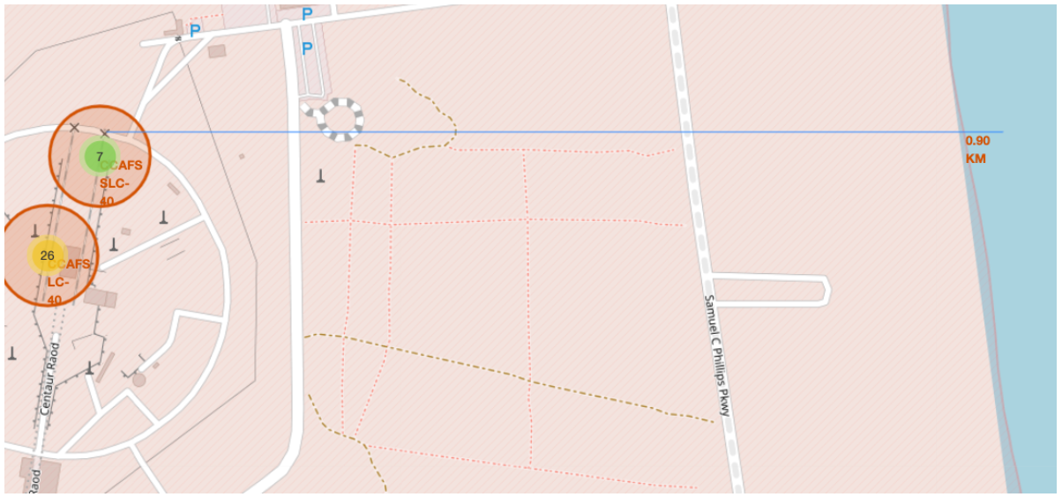
Distance between a launch site to its proximities

Slide 39

Section 4

Slide 40
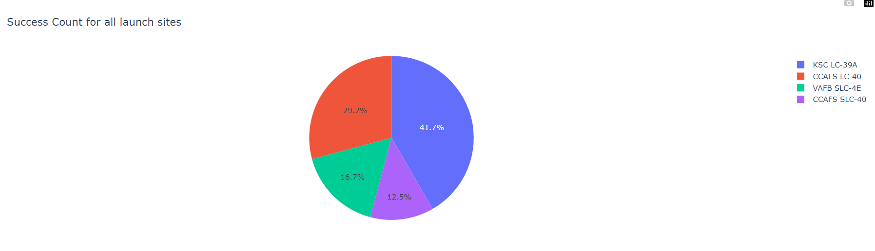
Total successful launches by all sites
We can see that KSC LC-39A had the most successful launches from all the sites

Slide 41
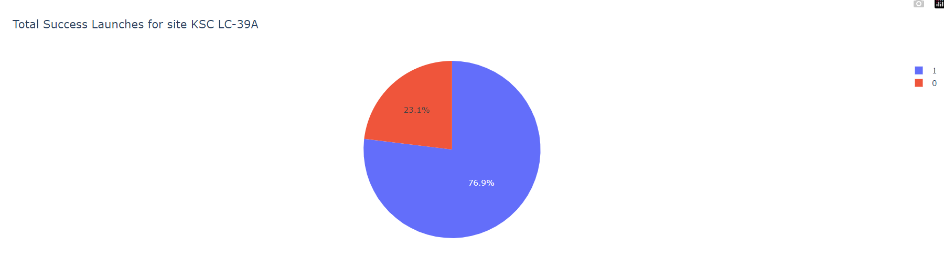
Success rate by site
KSC LC-39A achieved a 77% success rate while having a 23.1% failure rate

Slide 42
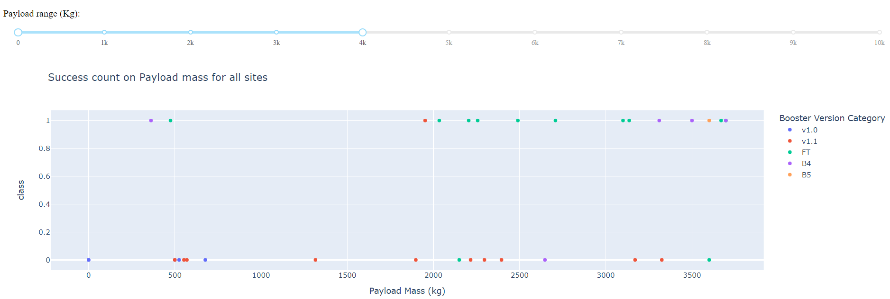
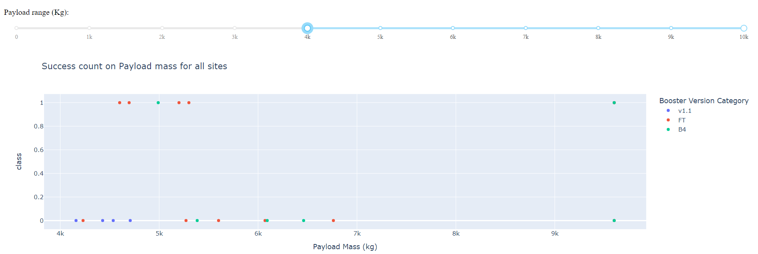
Payload vs Launch Outcome
We can see success rates for low weighted(0kg-4000kg) payloads is higher than the heavy weighted(4000kg-10000kg) payloads

Slide 43

Section 5

Slide 44
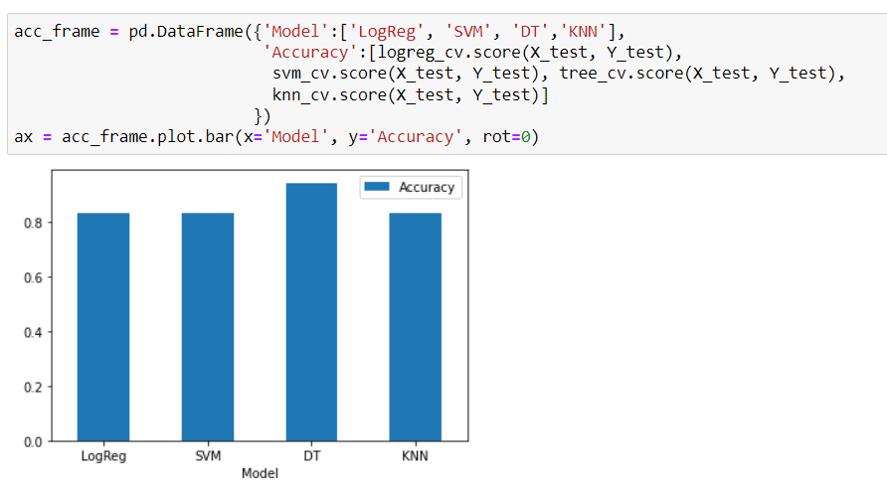
Classification Accuracy

Slide 45
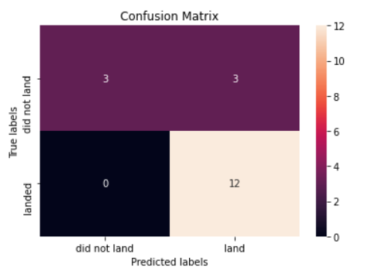

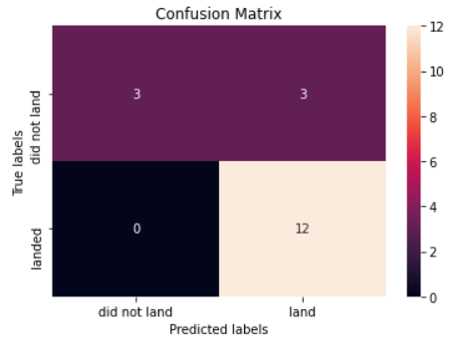
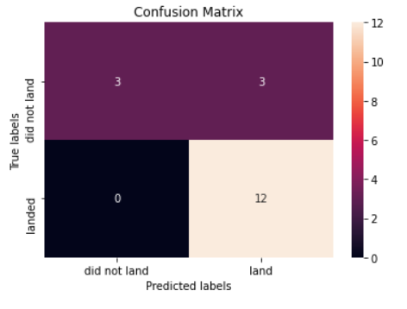
Confusion Matrix

Slide 46
Conclusions
SVM, KNN and Logistic Regression is best in terms of accuracy.
Decision Tree results looks overfitted
Low-weighted payloads perform better than heavy-weight payloads
The success rates of SpaceX launches is directly proportional to time. With advancement in technology and in years to come they will perfect the launches.
KSC LC-39A and VAFB SLC 4E has success rates of 77%
LEO orbit the Success appears related to the number of flights; on the other hand, there seems to be no relationship between flight number when in GTO orbit.

Slide 47


